Slide 1

Artist Classification
Based on Song Lyrics
CSCI 6360 Data Science II
Shuangyan Wu, Max Firminhac, Michael Williams
12/05/2022

Slide 2
Content
Introduction and Data Summary
2. Data Preprocessing
3. Word Embedding
4. Predictive Modeling
5. Results and Conclusions

Slide 3
Part 1: Introduction and Data Summary

Slide 4
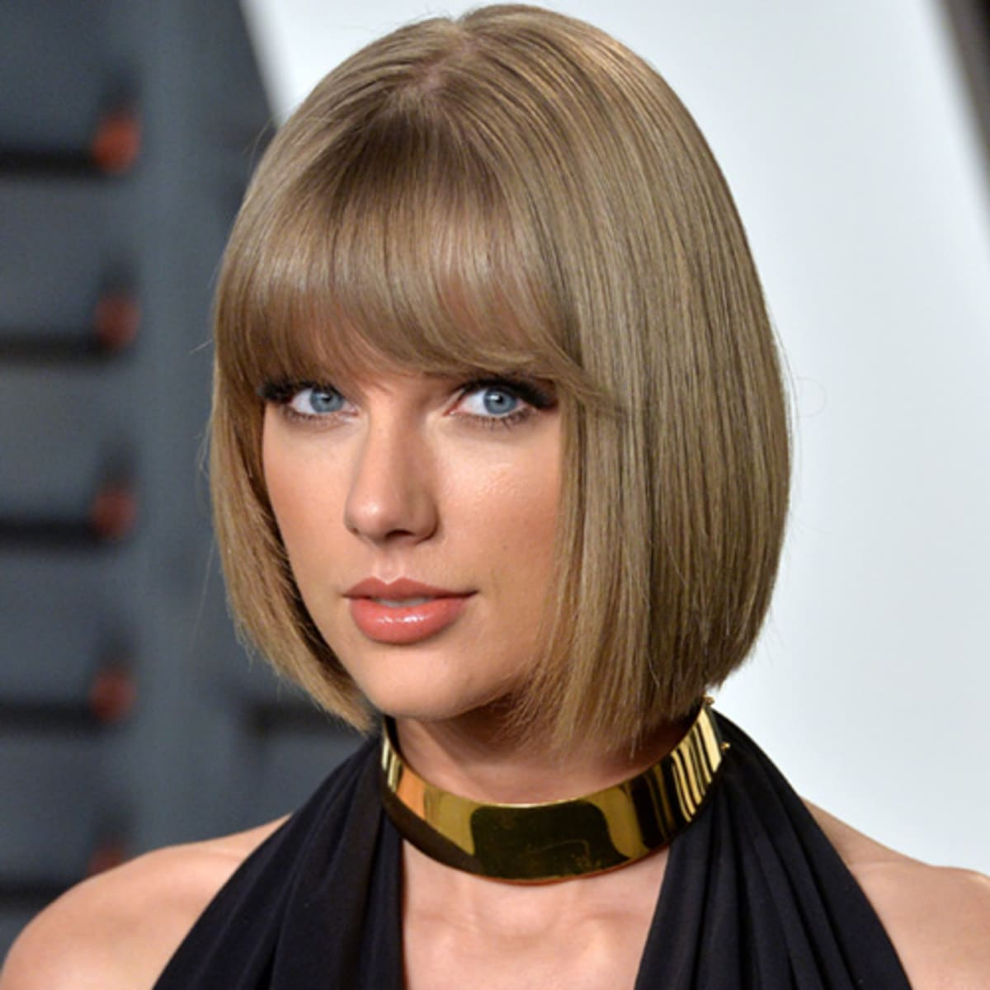
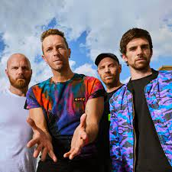
That's what people say,
But I keep cruisin'
Can't stop, won't stop movin'
It's like I got this music in my mind
Sayin' it's gonna be alright
'Cause the players gonna play, play, play, play, play
And the haters gonna hate, hate, hate, hate, hate
Baby, I'm just gonna shake, shake, shake, shake, shake
I shake it off, I shake it off
“I used to rule the world
Seas would rise when I gave the word
Now in the morning, I sleep alone
Sweep the streets I used to own
I used to roll the dice
Feel the fear in my enemies' eyes
Listen as the crowd would sing
"Now the old king is dead, long live the king"
One minute, I held the key
Next, the walls were closed on me
Taylor Swift
- Shake It Off
Coldplay
- Viva La Vida

Slide 5
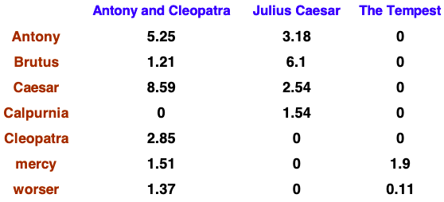
Text mining (Lyrics to Vectors)
Bag-of-Words/Term-doc count matrix
IF-IDF Weight Matrix
2. ML Prediction Models
Naive Bayes (NB)
Support Vector Machine (SVM)
Task: Build Classification Models
Lyric 1
Lyric 2
Lyric 3
Artist name
Vector

Slide 6
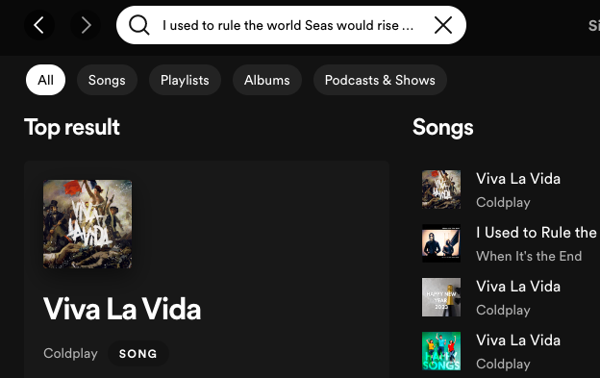
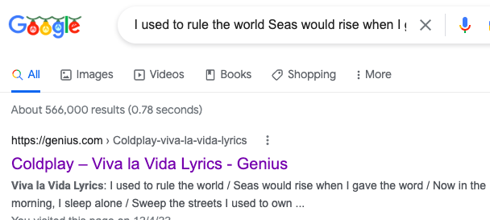
Applications
Search engines
e.g. Google
Music streaming platforms
e.g. Spotify

Slide 7
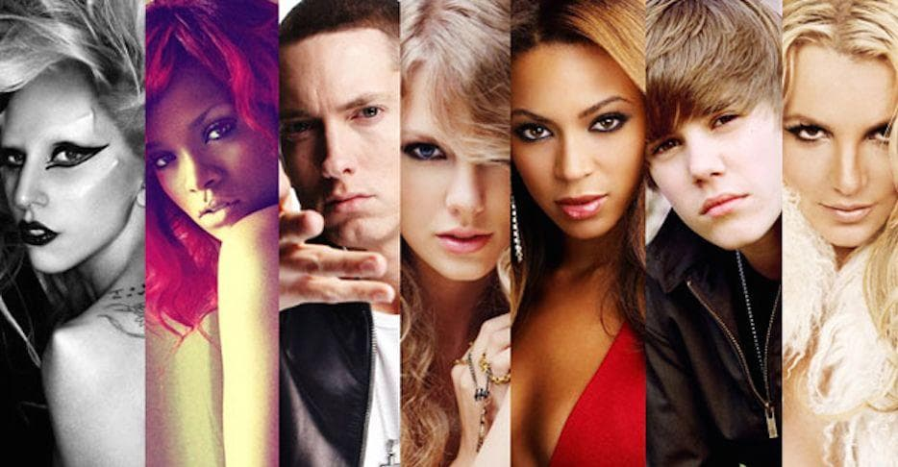
Data Summary
Description | Combined dataset from different files
Variables | Index Artist Title Album Year Date Lyric
Original Size | 6027 * 7 (21 artists)
Size after cleaning | 4970 * 7 (18 artists)
Training set (70%)
Testing set (30%)
Average: 276 songs/artist

Slide 8
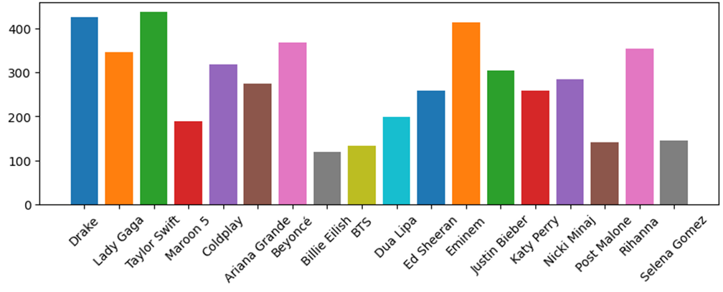
Data Summary

Slide 9
Part 2: Data Preprocessing

Slide 10
Select artists: number of songs > 100
Remove:
Khalid (64 songs)
CardiB (75 songs)
CharliePuth (75 songs)
Artists

Slide 11
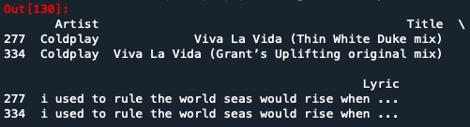
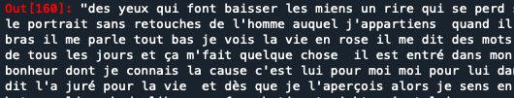
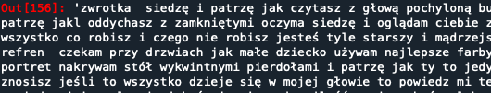
Songs with no lyrics (NaN)
Songs with duplicated lyrics
Songs with non-English lyrics
Lyrics
(Lady Gaga)
(Taylor Swift)

Slide 12
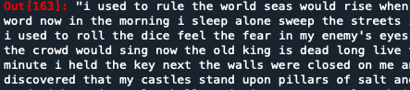
Already applied
Tokenization
Case Folding
e.g. the, a, and, to, be.
Remove or not? Tried both
Stop words
Reduce terms to their “roots”
e.g. accepted - accept
Applied or not? Tried both
Snowball stemmer
Stemming

Slide 13
Part 3: Word Embedding

Slide 14
Bag-of-Words
Intuition:
Documents with similar content are similar
Measures vocabulary and strength of presence
Limitation: Does not consider order of words

Slide 15
Bag-of-Words
Which documents are most similar?
A
B
C

Slide 16
Bag-of-Words
Documents A and B both have 3 squares and 3 triangles
A
B
C

Slide 17
Bag-of-Words
Why is it called Bag-of-Words?
[“this”, “is”, “an” “example”, “sentence”]

Slide 18
Bag-of-Words Example
Consider the following three “documents”:
[“max”, “is”, “from”, “wisconsin”]
[“michael”, “studies”, “at”, “university”, “georgia”]
[“yan”, “lives”, “in”, “georgia”]

Slide 19
Bag-of-Words Example
Consider the following three “documents”:
[“max”, “is”, “from”, “wisconsin”]
[“michael”, “studies”, “at”, “university”, “georgia”]
[“yan”, “lives”, “in”, “georgia”]
Vocabulary:
[“max”, “is”, “from”, “wisconsin”, “michael”, “studies”, “at”, “university”, “georgia”, “yan”, “lives”, “in”]

Slide 20
Vocab | D1 | D2 | D3
max | 1 | 0 | 0
is | 1 | 0 | 0
from | 1 | 0 | 0
wisconsin | 1 | 0 | 0
michael | 0 | 1 | 0
studies | 0 | 1 | 0
at | 0 | 1 | 0
university | 0 | 1 | 0
georgia | 0 | 1 | 1
yan | 0 | 0 | 1
lives | 0 | 0 | 1
in | 0 | 0 | 1

Slide 21
TF-IDF
Intuition:
Stands for “term frequency-inverse document frequency
Penalizes common vocabulary
Ex: “I”, “love”, “you” in love songs

Slide 22

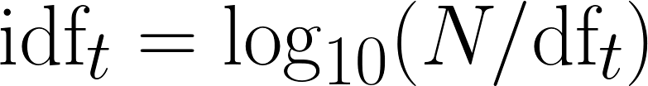
TF-IDF
IDF:
is the document frequency of word t
Inverse document frequency:

Slide 23
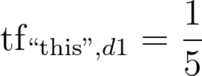
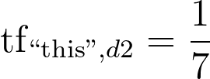
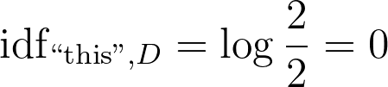
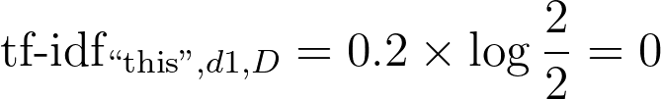
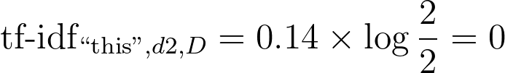
TF-IDF Example
Document A
Term | Count
this | 1
is | 1
a | 2
sample | 1
Document B
Term | Count
this | 1
is | 1
another | 2
example | 3

Slide 24
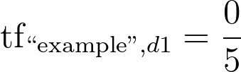
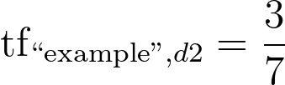
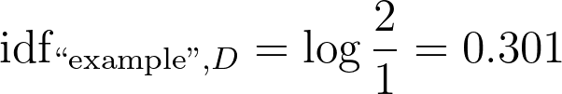
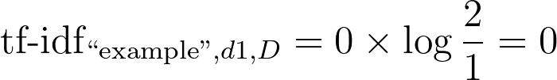
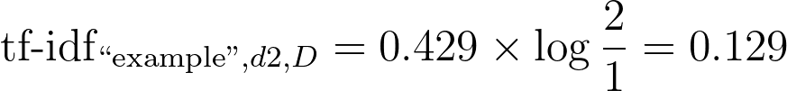
TF-IDF Example
Document 1
Term | Count
this | 1
is | 1
a | 2
sample | 1
Document 2
Term | Count
this | 1
is | 1
another | 2
example | 3

Slide 25
Part 4: Predictive Modeling

Slide 26
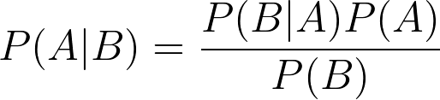

Naive Bayes Classifier
Bayes Theorem:
We call this formulation the posterior, which is the product of the sampling likelihood and the prior distribution

Slide 27
Naive Bayes Classifier
Consider with label y and p features: x1, ..., xp:
The “naive” assumption:

Slide 28

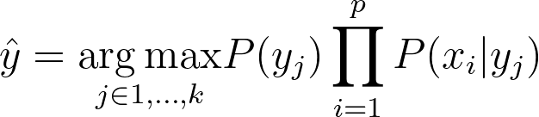
Naive Bayes Classifier
Consider
Then the NBC model is:

Slide 29
Naive Bayes Classifier
Why use this model?
Calculation of probabilities is easy and intuitive given term frequence features

Slide 30
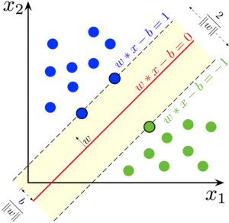
Support Vector Machine (SVM)
Attempts to find the hyperplane with largest margin between two classes
Uses support vectors to define the margin

Slide 31
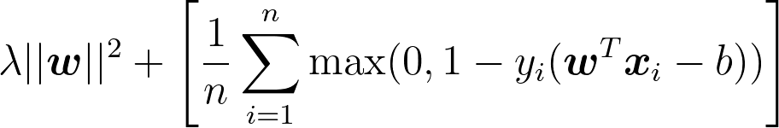
SVM
Loss function: (hinge loss)
Updated using gradient descent

Slide 32
SVM
Why use this model?
Computationally efficient
Also works well with text classification

Slide 33
Part 5: Results

Slide 34
Effect on Accuracy of Removing Stop Words
Naive Bayes
0.357 0.512
Support Vector Machine
0.696 0.696
Notes:
One of the main metrics we looked at to determine the performance of a classifier was accuracy.
During preprocessing, we looked at the effect of removing stop words.
For Naive Bayes, this improved accuracy by about .2
For SVM, this had no change. Going forward, we removed stop words for both models.

Slide 35
Effect on Accuracy of Stemming
Naive Bayes
0.357 0.512
0.480
Support Vector Machine
0.696 0.696
0.677
Notes:
We then looked at how stemming changes accuracy.
In both cases accuracy decreased.
We decided not to use stemming.

Slide 36
Accuracy of Best Model
Naive Bayes: Remove stop words. Don’t perform stemming.
Accuracy: 0.716
SVM: Remove stop words. Don’t perform stemming.
Accuracy: 0.713
Notes:
For the final choice of models, we remove stop words and don’t perform stemming.
Accuracy for both models is comparable.

Slide 37
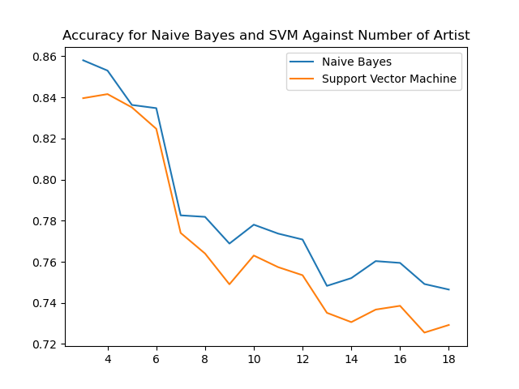
Effect of Adding More Artist
Notes:
We were also curious how sensitive these models were to the number of artist.
If we only trained on 3 artist, then we’d expect really high accuracy. But 2000 might give us more trouble.
[explain chart]
[Does seem to stabilize a bit.]

Slide 38
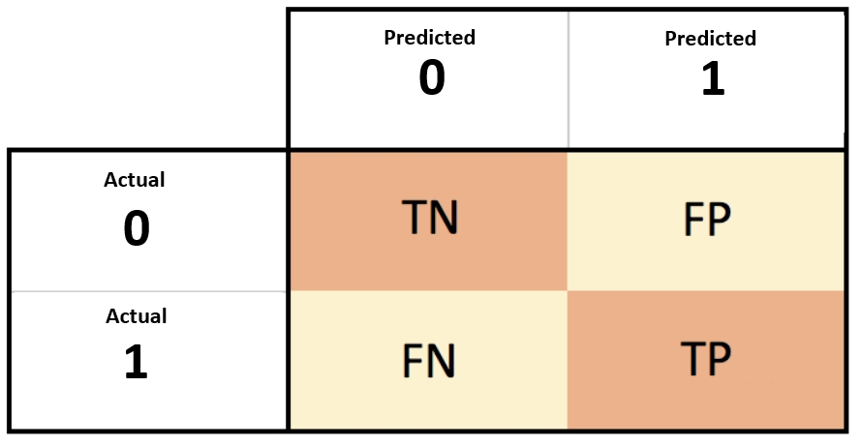
Confusion Matrix
Notes:
So far we’ve been looking at accuracy.
Another way to evaluate these models is with a confusion matrix.
Binary case is simple
For a multi-class problem, we can use a similar idea.

Slide 39
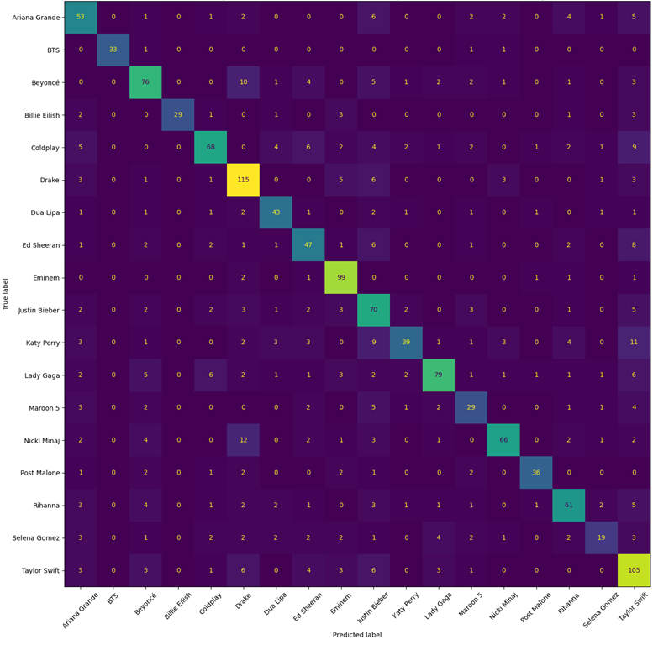
Multilabel Confusion Matrix for Naive Bayes Classifier
Notes:
Multilabel confusion matrix for NB
Vertical is true labels. Horizontal is predicted.
Ex: 115 times we predicted drake when it was actually drake.
Interesting things: Drake and Nicki. Taylor Swift and Katie Perry
Eminem recall.
Post Malone precision.

Slide 40
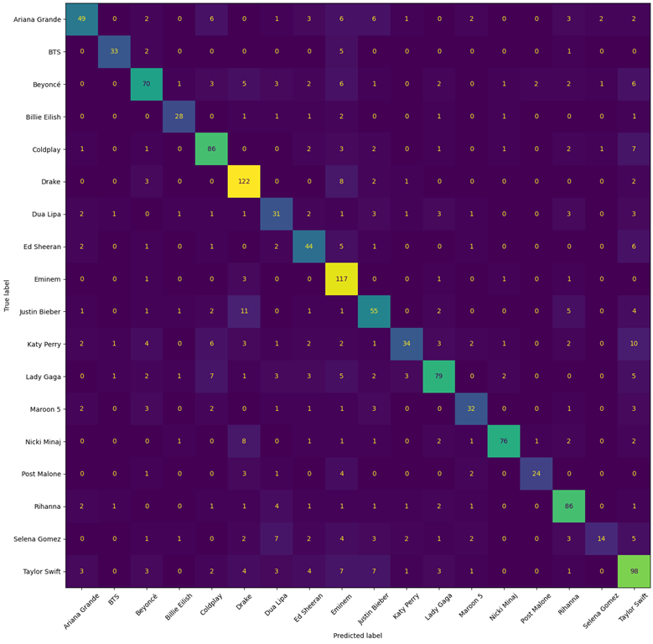
Multilabel Confusion Matrix for Support Vector Machine
Notes:
Multilabel confusion matrix for SVM
Similar
Nicki minaj has good precision.

Slide 41
Artist with Best Precision (Naive Bayes)
BTS | 1.00
Billie Eilish | 1.00
Post Malone | 0.88
Nicki Minaj | 0.85
Lady Gaga | 0.84
Notes:
We can look at the metrics for each artist individually.
Here we’re showing the top 5 artist with the best precision for the Naive Bayes model.

Slide 42
Artist with Best Recall (Naive Bayes)
Eminem | 0.94
BTS | 0.92
Drake | 0.83
Dua Lipa | 0.77
Post Malone | 0.77

Slide 43
Artist with Best f1-score (Naive Bayes)
BTS | 0.96
Eminem | 0.86
Billia Eilish | 0.84
Post Malone | 0.82
Drake | 0.76

Slide 44
Artist with Best Precision (SVM)
Nicki Minaj | 0.92
BTS | 0.89
Post Malone | 0.89
Billie Eilish | 0.82
Lady Gaga | 0.79

Slide 45
Artist with Best Recall (SVM)
Eminem | 0.94
Drake | 0.88
Rihanna | 0.83
BTS | 0.80
Coldplay | 0.80

Slide 46
Artist with Best f1-score (SVM)
BTS | 0.85
Nicki Minaj | 0.85
Drake | 0.81
Billie Eilish | 0.80
Rihanna | 0.80
Notes:
—--
All of these metrics are looking just at the top prediction.
In practice, we likely would report a list of likely artist to the user.

Slide 47
Performance of Rank Ordering
Query: "One day I'll watch as you're leaving"
Ed Sheeran ( 0.389 )
Taylor Swift ( 0.325 )
Katy Perry ( 0.062 )
Maroon 5 ( 0.058 )
Selena Gomez ( 0.044 )
Notes:
Example:
[Is a Taylor Swift Lyric]
How often is the true value in the top k?

Slide 48
Performance of Rank Ordering
Accuracy of Model Matching Top k Artist
 | 1 | 2 | 3 | 4 | 5
NB | 0.716 | 0.813 | 0.846 | 0.865 | 0.887
SVM | 0.713 | 0.809 | 0.840 | 0.870 | 0.891

Slide 49
List of All Artist
Ariana Grande
BTS
Beyoncé
Billie Eilish
Coldplay
Drake
Dua Lipa
Ed Sheeran
Eminem
Justin Bieber
Katy Perry
Lady Gaga
Maroon 5
Nicki Minaj
Post Malone
Rihanna
Selena Gomez
Taylor Swift

